Slide 1
Superconvergence and adaptive refinements in FEM
Alexander Demidov
St. Petersburg State University
Applied and
Computational Physics

Slide 2
Finite elements method, main ideas
Superconvergence in approximation of the derivative
Review of adaptive refinements

Slide 3
Why we should speak about FEM?
Nowadays it is one of the most powerful
computational tools at our hands
Boundary conditions of different type
Easy accounting complex geometry of the object
Widely used
Subject is developing and many important
supplements are continuously appearing

Slide 4
History remarks
Variational methods
(Rayleigh 1870, Ritz 1909)
Weighted residuals
(Galerkin 1915, Biezeno-Koch 1923)
Finite differences
(Richardson 1910, Liebman 1918)
Structural analogue substitution
(Newmark 1949)
Piecewise continuous trial functions
(Courant 1947, Zienkieviech 1964 )
Variational finite differences
(Varga 1962)
Direct continuum elements
(Argyris 1955, Terner et al. 1956)
A present day Finite Elements Method

Slide 5


FEM. Main idea
Replacement of the problem in the infinite dimensional space by finite analogue
Consider linear differential operator

Slide 6

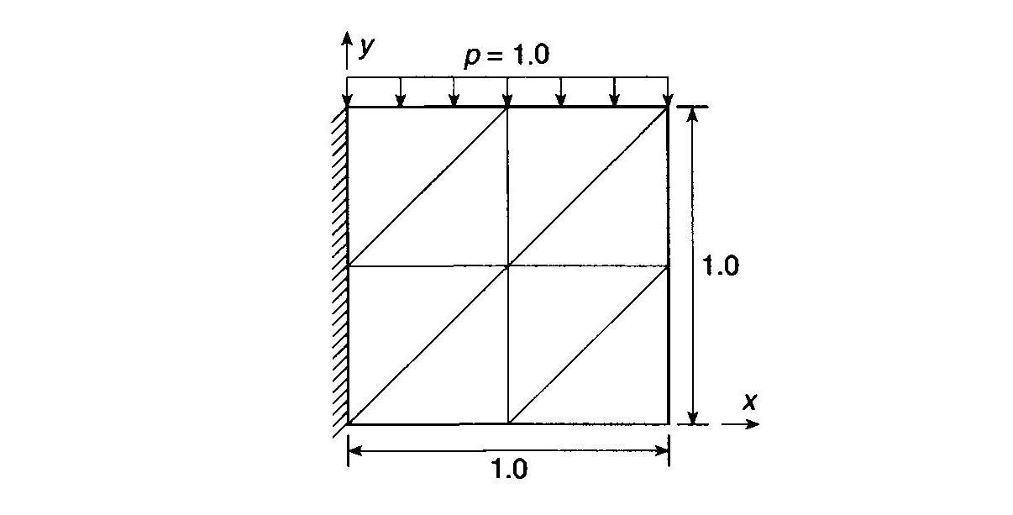
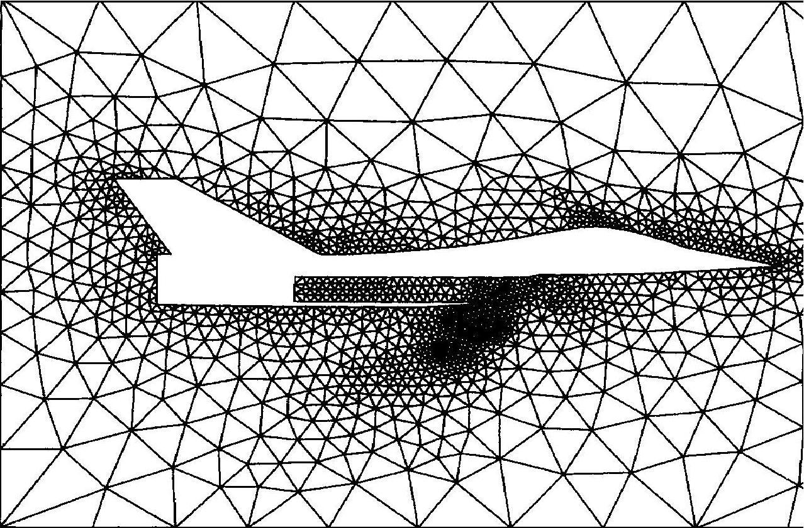
FEM. Subspaces
One chooses a grid on Ω. It consists (in general) of some closed areas:
in 2D case it is triangles, squares or either curvilinear polygons.

Slide 7



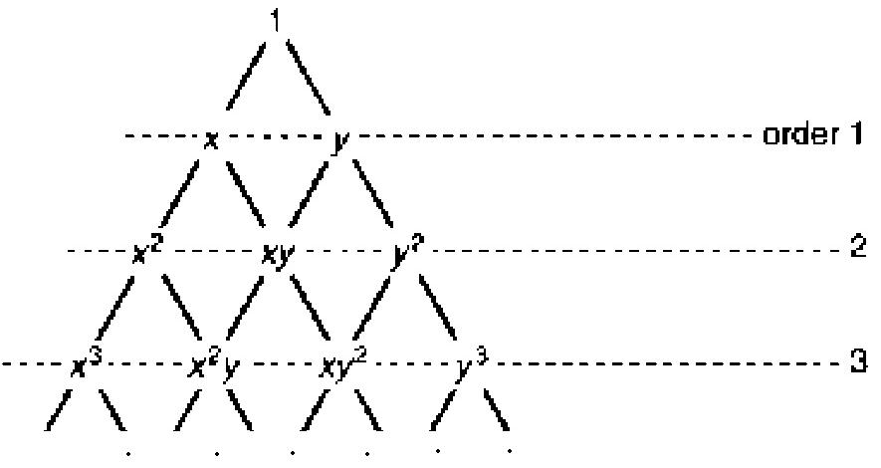
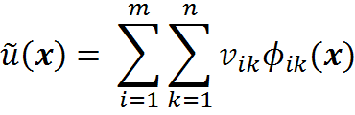
Basic functions
On each subdomain we can take some finite set of basis functions
Normalized
- Nodes of the element
Corresponds to the
order of approximation

Slide 8
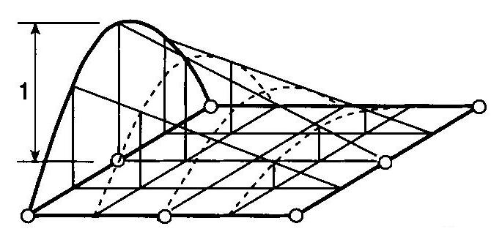
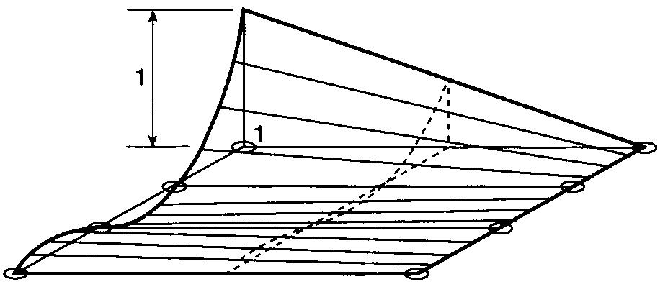
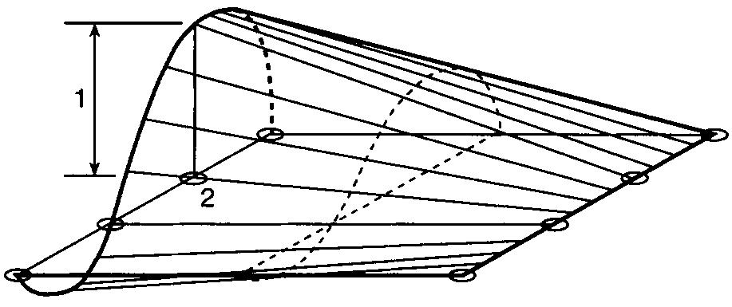


Basis functions (2D examples)
quadratic
cubic
cubic

Slide 9

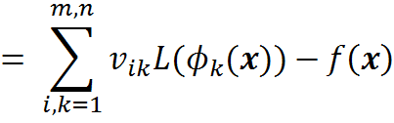


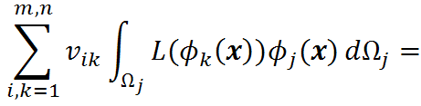
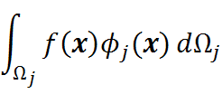
Discretization
Residual due to linearity of can be rewritten as:
Constructing the linear algebraic system by weighting with

Slide 10
Finite elements method, main ideas
Superconvergence effect in approximation of derivative
Review of adaptive refinements

Slide 11

Superconvergence. Problem definition
Solution of a problem obtained by FEM
If the highest power of basis function is n then the error estimation will be following

Slide 12
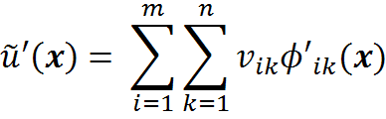



Superconvergence. Problem definition
For derivative of the solution
Error estimation is
Have we enough information to define more accurate ?

Slide 13

Superconvergence. The test problem
The problem
Parameters of the method
n – number of basic functions
m – number of finite elements
  n = 2 (linear approximation),
  m = 2, 4 (number of finite elements)
  n = 3 (quadratic approximation),
  m = 2, 4

Slide 14
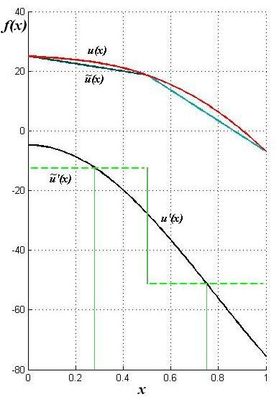
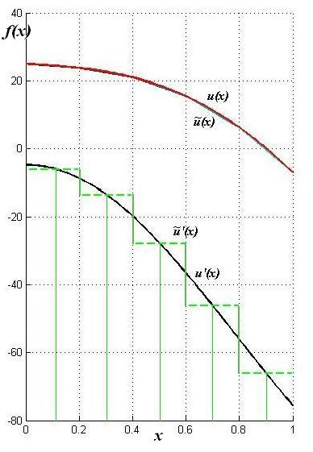


1)
exact solution and its derivative
numeric solution and its derivative

Slide 15
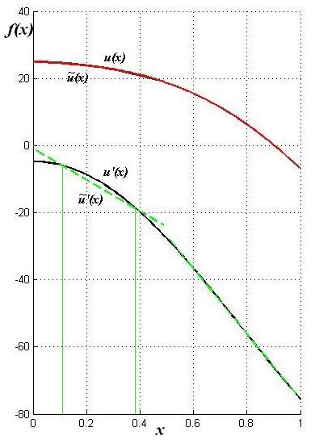
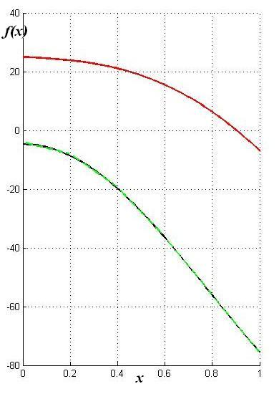
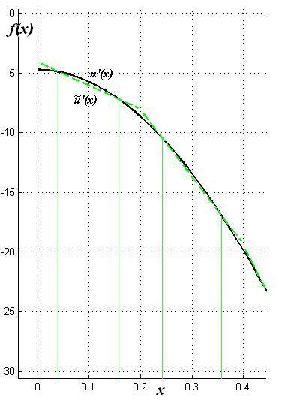
2)
exact solution and its derivative
numeric solution and its derivative

Slide 16
Superconvergence effect
(Barlow)
Best accuracy of the FEM solution is obtainable for gradients at the Gauss points corresponding, in order, to the polynomial used in the solution
Interpolating data, obtained in Gauss nodes
(polynomial of corresponding degree)

Slide 17
Superconvergence effect. High dimensional elements
Rectangles (parallelepipeds) – Cartesian product of the corresponding point on the line (plate)
Triangles (tetrahedrons) – superconvergence points doesn't exist, but still there are some optimal sampling points

Slide 18
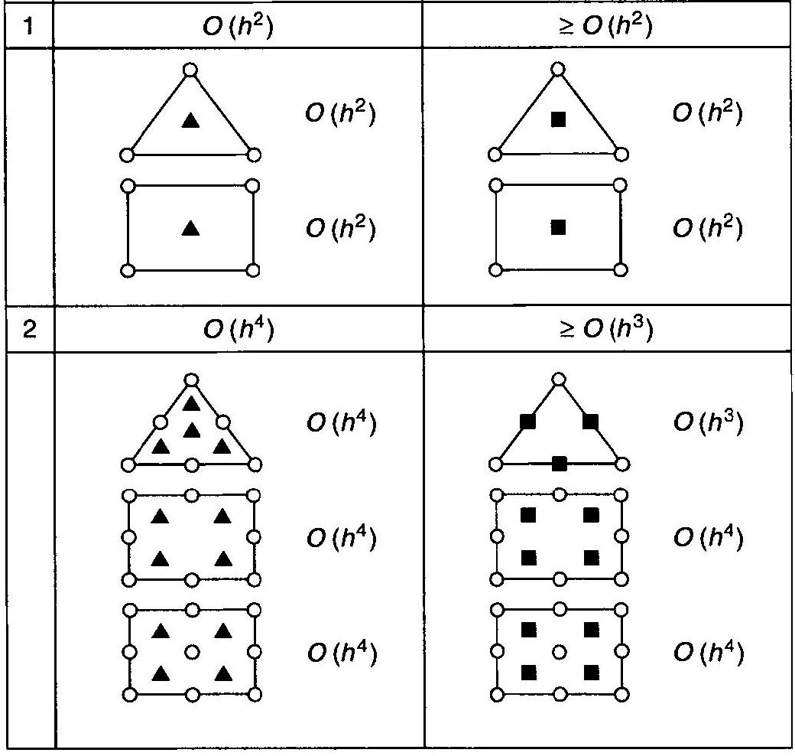
Superconvergence effect. High dimensional elements

Slide 19
Superconvergence effect. Algorithm
Map Gauss-Legandre nodes at the finite element (Define points of superconvergence)
Add to the superconvergence points some additional ones from neighbor elements
Fit the obtained data in the list square sense

Slide 20
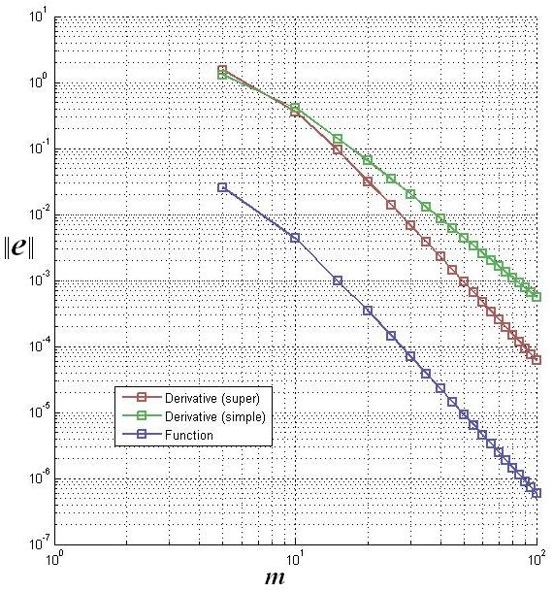
Superconvergence. Speed of convergence
Parameters of the method:
n = 4 (cubic approximation), p = 2 (number of additional points in superconvergence algorithm)

Slide 21
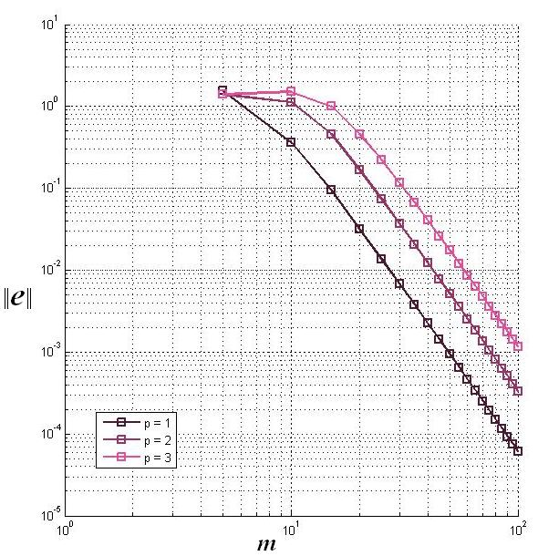
Superconvergence. Speed of convergence with different number of outer points

Slide 22
Finite elements method, main ideas
Superconvergence effect in approximation of derivative
Review of adaptive refinements

Slide 23
Adaptive FE refinement. Main idea
Adaptive refinement (depends
on previous results)
h-refinement
Same type of elements
Same type of basis functions
Elements becomes smaller (larger)
p-refinement
Same size of elements
Increases order of approximation functions (locally or throughout whole domain)

Slide 24
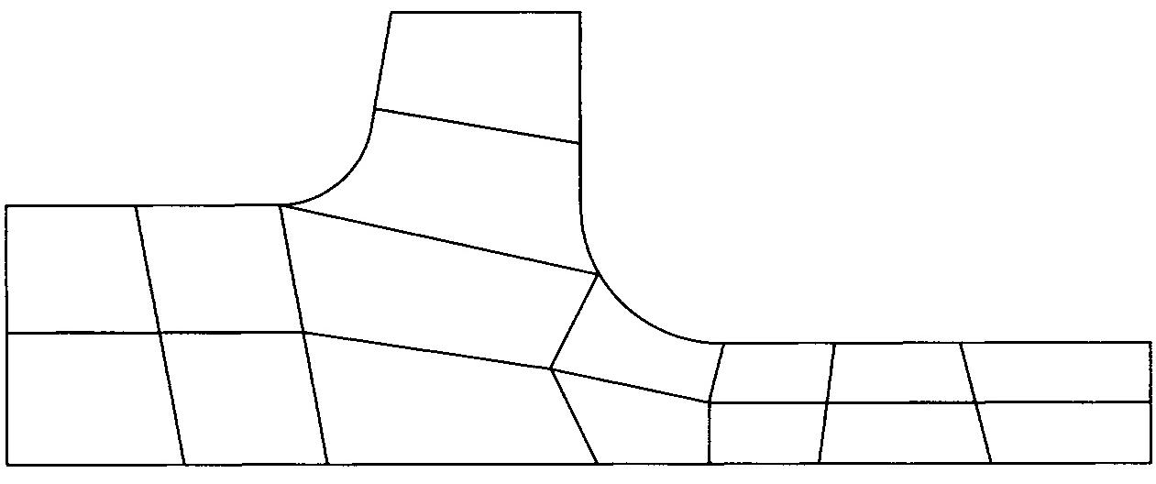
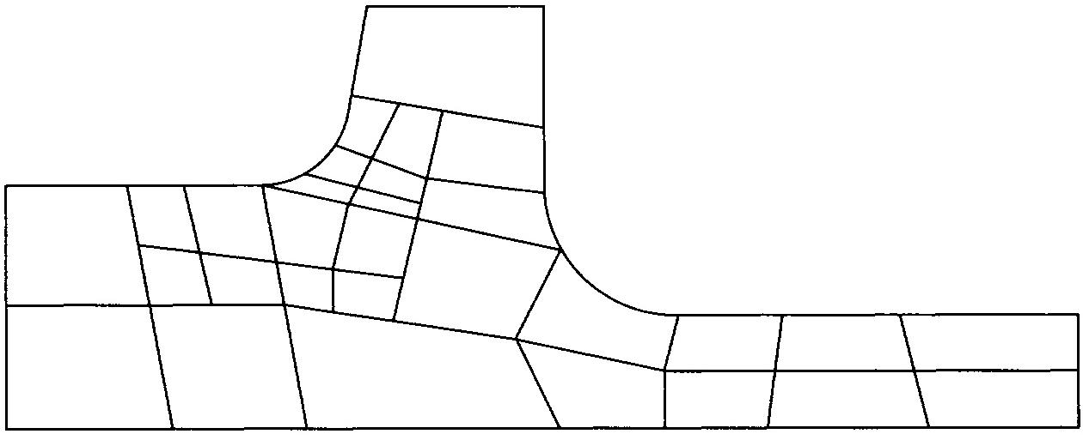
Adaptive FE refinement, h-refinement
Element subdivision (enrichment)
rather simple and widely used

Slide 25
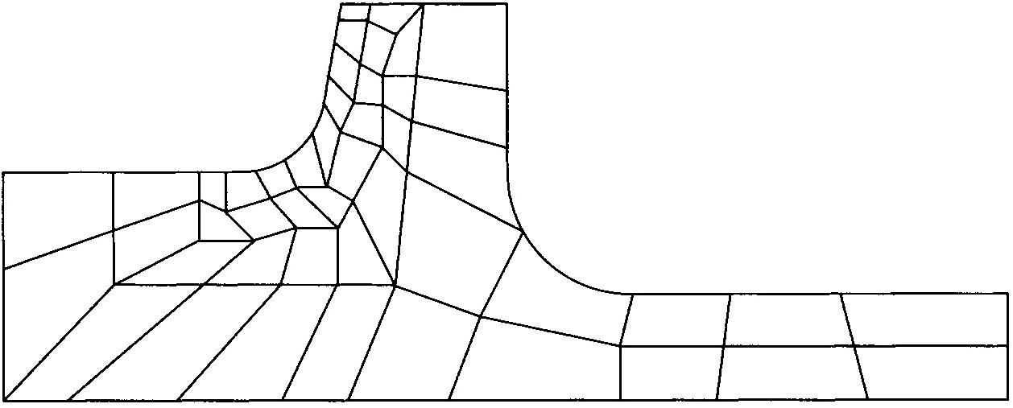
Adaptive FE refinement, h-refinement
Mesh regeneration;
problem of transferring data
results are generally much superior than
in previous case

Slide 26
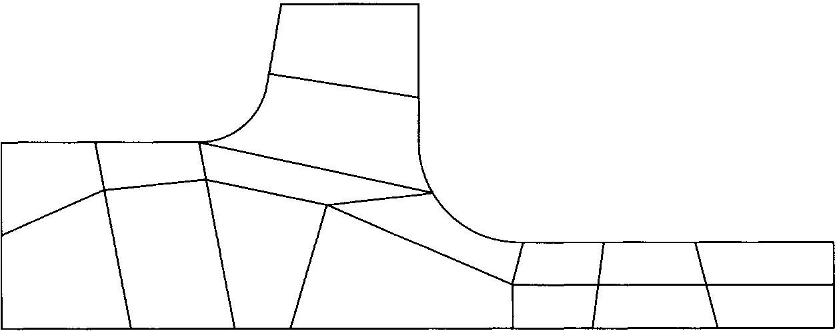
Adaptive FE refinement, h-refinement
Reposition of the nodes
difficult to use in practice

Slide 27
Conclusions
Sampling data in superconvergence points – way to improve accuracy of derivative of the FEM solution
Adaptive refinement of FEM mesh – way to improve accuracy of solution

Slide 28
References
Zienkiewicz O.C., Taylor R.L. Vol. 1. The finite element method. The basis
Chuanmiao Chen. Element analysis method and superconvergence
Boyarshinov M. G. Computational methods. Part 3

Slide 29
Thank you for your
attention

